Slide 1
Data
SUL Advisory Council Meeting
May 31, 2013

Slide 2
Topics
Data Services Web Site
Data Management Planning Tool (DMP Tool)
Data Pilot Projects for the Stanford Digital Repository (SDR)
Future

Slide 3
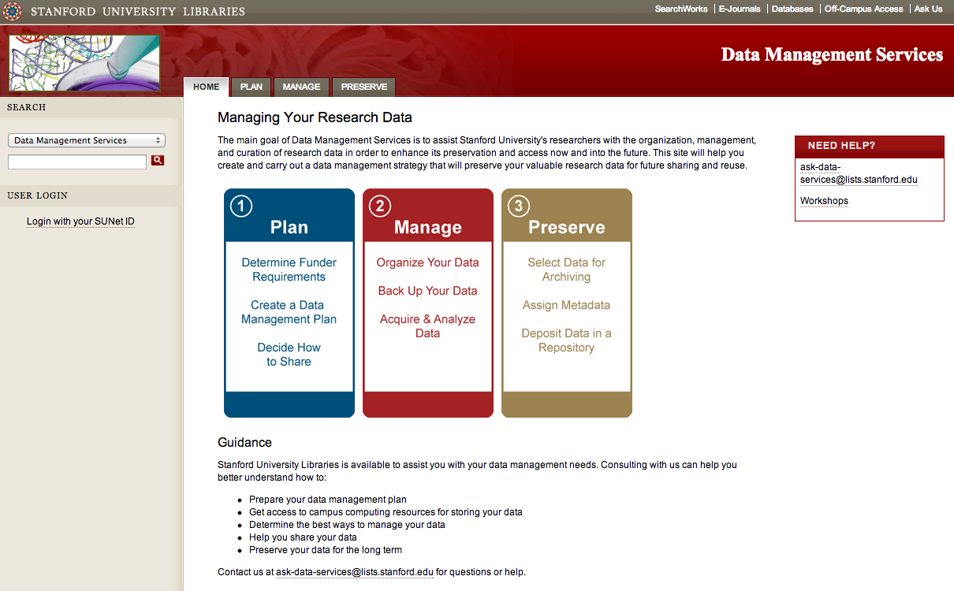
Data Services Web Site
Notes:
Two of the most popular pages on this site are the DMPTool page and the page that lists subject specific repositories. Screen shots of those follow.
Most visited: home page
Second: DMP Tool
Third: Subject-Specific Data Repositories

Slide 4
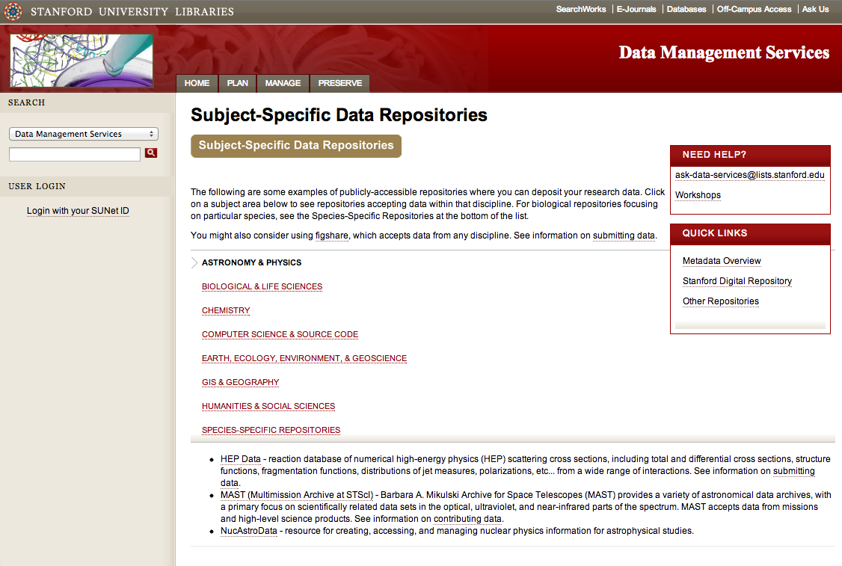
Subject-Specific Data Repositories

Slide 5
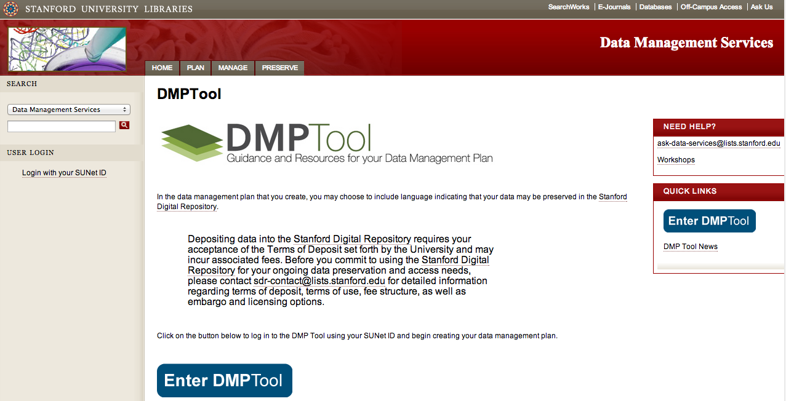
DMP Tool

Slide 6
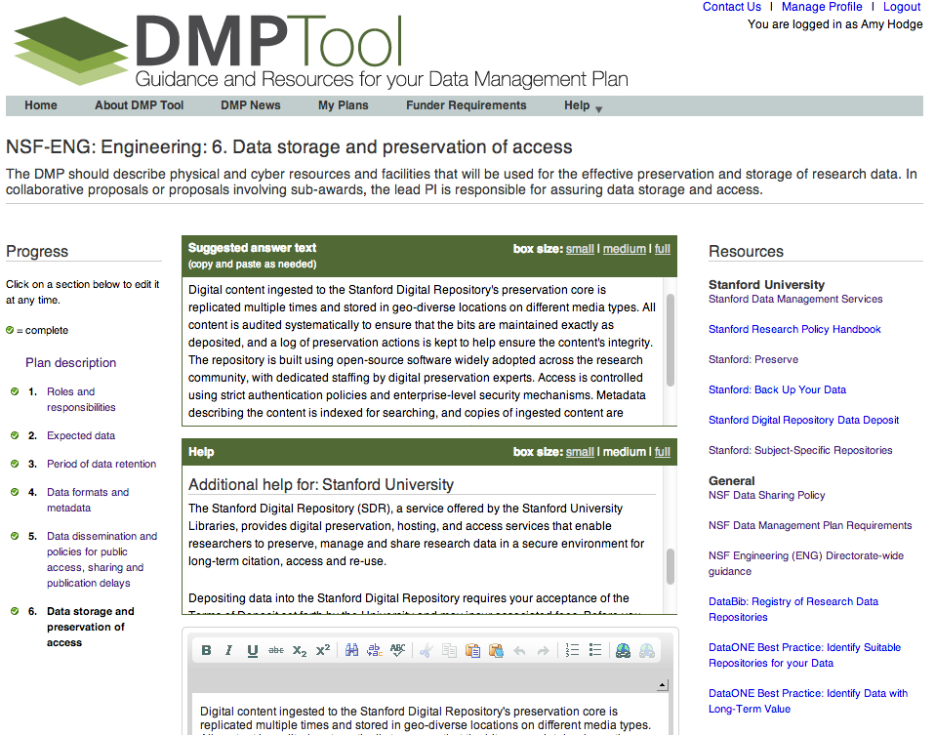
Notes:
85 institutions with single sign-on
As of February 11, Stanford usage stats:
119 users
47 have created plans
Most users added when we were giving workshops in the fall and in response to an email about it that went out from the Dean of Research’s office.
This screen shot shows an example where we have contextualized Help text, Suggested Answer text, and links to Stanford sites with additional information.

Slide 7
Data Pilot Projects
Working with Stanford researchers
Stanford Digital Repository (SDR) for data preservation, sharing, and
Real-world data ➔ real-word data issues
Assess user needs ➔ services & resources
Researcher receives PURL(s) to share data
Variety of use cases uncovered so far

Slide 8
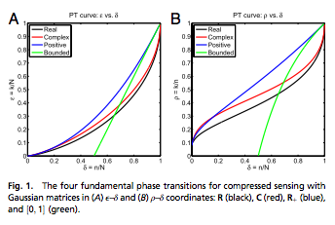
PURL for Publication Support: David Donoho, Statistics
Paper in press in Proceedings of the National Academy of Sciences (PNAS)
Required to publish data somewhere, but the journal did not provide a place
The PURL itself was required prior to data publication for the galley proof

Slide 9
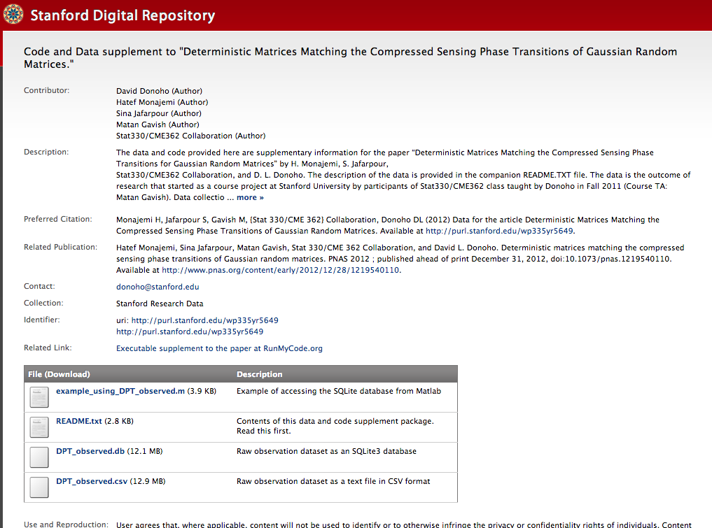
PURL for Publication Support
PNAS link
RunMyCode link
Notes:
This was our first data PURL. Library staff did all the work to generate this. This group’s second publication PURL was recently completed and they were able to do all of it themselves.

Slide 10
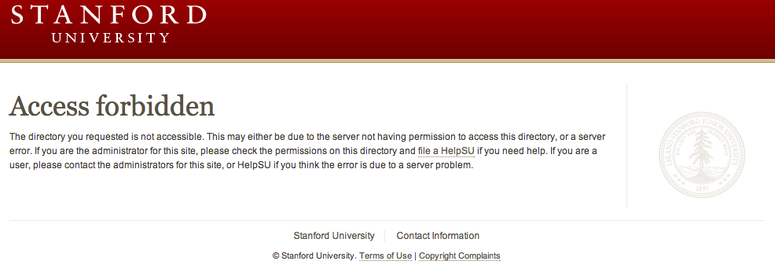
PURL for Restoring Data Access: Malin Pinsky, Hopkins Marine Station
Data was originally published on AFS space
URL to the data was published in a Conservation Biology article
Malin later left Stanford, his SUNet ID was deactivated, and the data became inaccessible

Slide 11
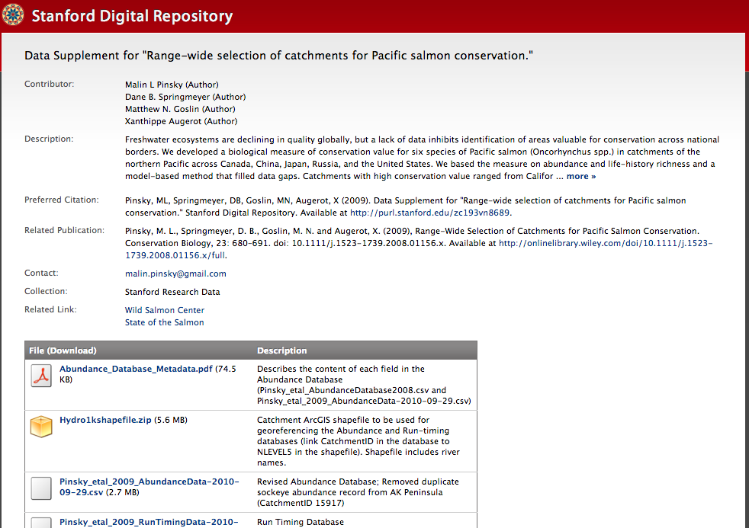
PURL for Restoring Data Access
www.stanford.edu/~mpinsky/salmon/ > purl.stanford.edu/zc193vn8689
Notes:
Originally-published URL has been redirected to the new PURL page so that those reading the article do not come up on a dead end.

Slide 12
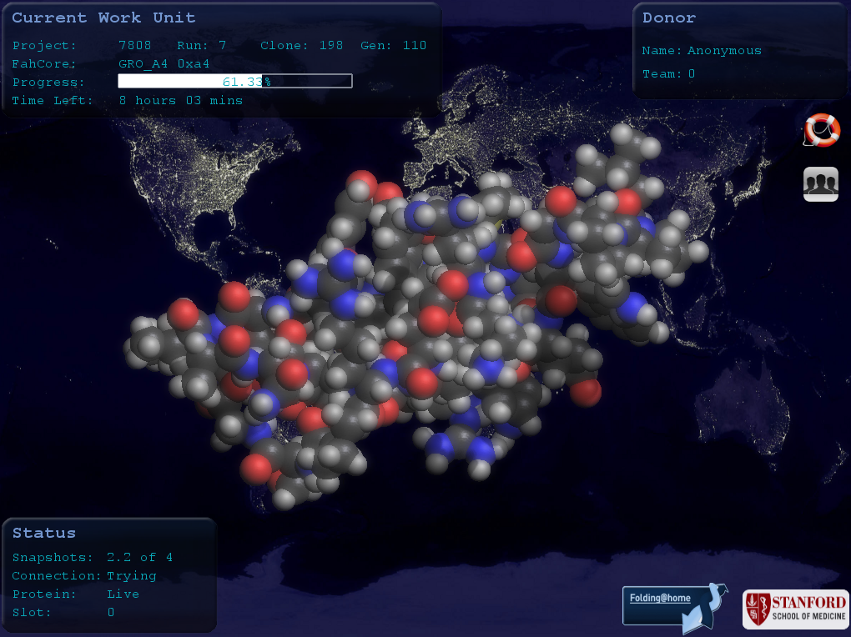
PURL for Discoverability: Vijay Pande & Folding@home
Computational protein folding project
Needed a place to organize and share a large number of very large files with the wider research community
Data is related to previous publications

Slide 13
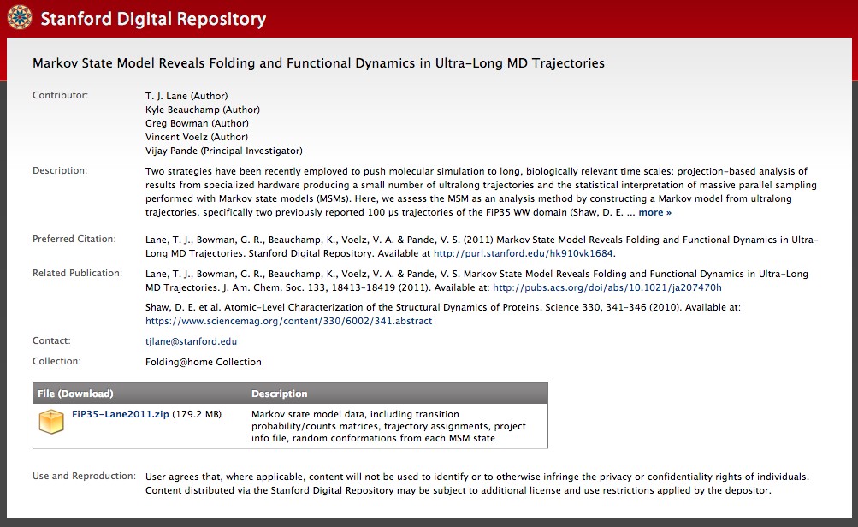
PURL for Discoverability
Folding@home
Collection

Slide 14
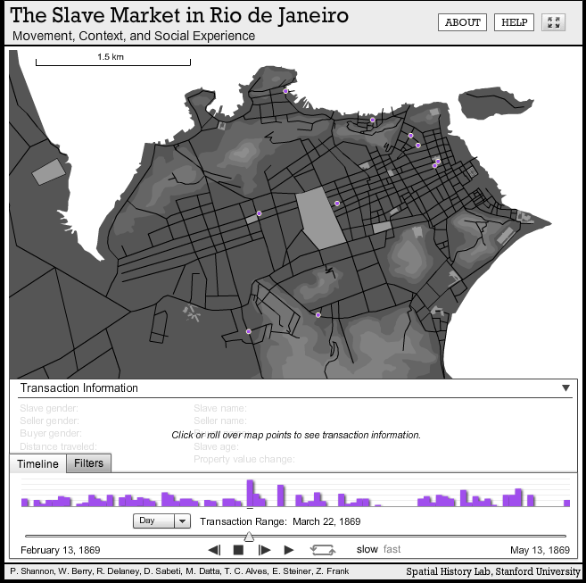
PURL for Original Publication: Spatial History Project
Data collected for projects and used to create online interactive visualizations
Typically includes compilation of historical data from a variety of different sources along with geospatial information
Desired a permanent, citable home for the underlying data files

Slide 15
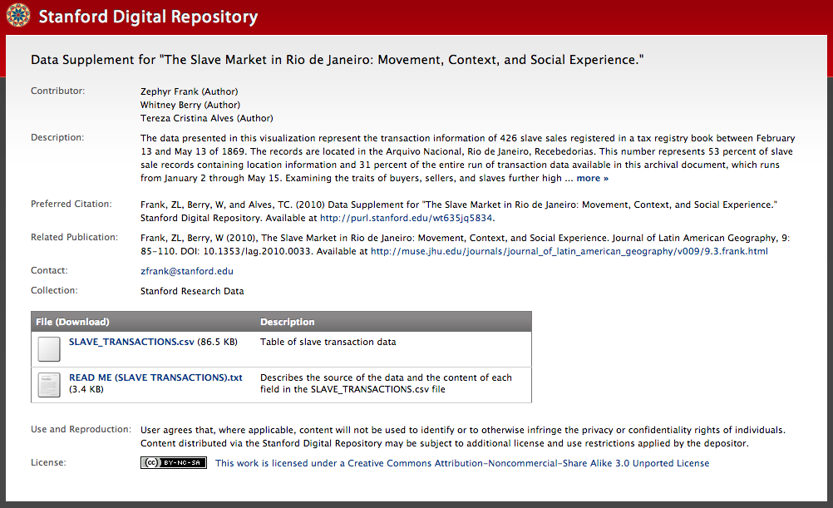
PURL for Original Publication

Slide 16
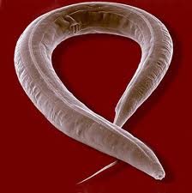
PURL for Data Sharing: Juan Cueva, Molec. & Cell. Physiology
Micrographs are information-rich, storage-intensive, and hard for people to access
They are done publishing > more questions could be asked of these images by others
Colleagues in India are interested in access
6 data sets with 150-400 images per data set
Deposits are in progress
Jürgen Berger & Ralph Sommer,
Max Planck Institute for Developmental Biology
Notes:
Molecular & Cellular Physiology

Slide 17
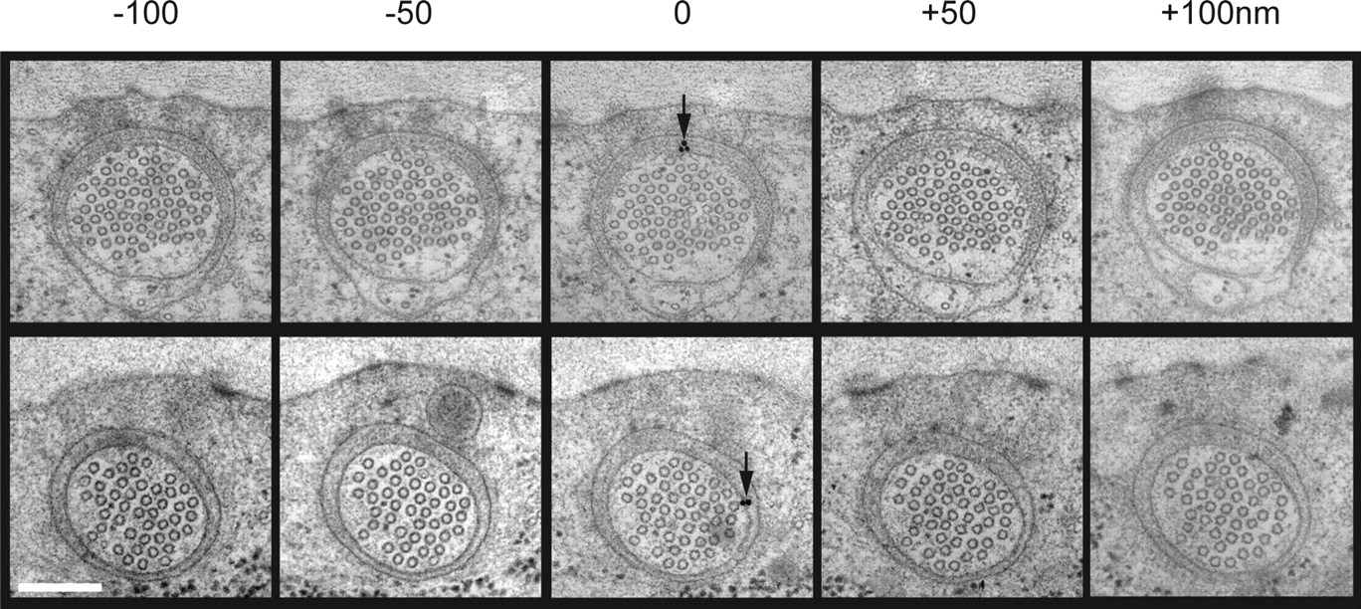

PURL for Data Sharing
©2007 by Society for Neuroscience
Cueva J G et al. J. Neurosci. 2007;27:14089-14098

Slide 18
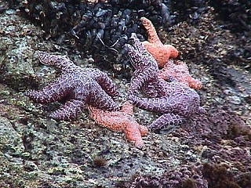
PURL for Preservation: Hopkins Marine Station
Data from a variety of Hopkins researchers
Much of the data involves long-term, on-going monitoring of sea otters, harbor seals, elephant seals, abalone, algae, sea stars, barnacles and weather data at the refuge
These data have never been consistently compiled in one place before for easy preservation and reuse

Slide 19
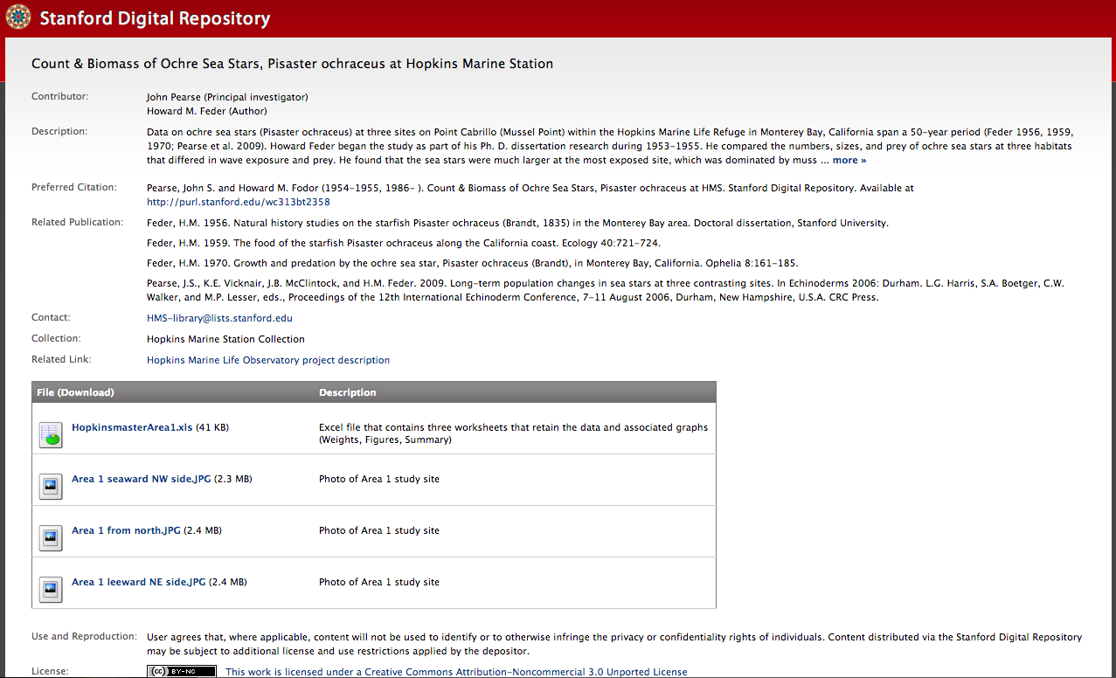
PURL for Preservation

Slide 20
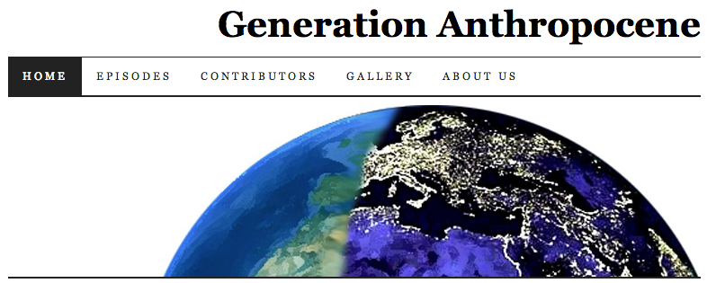
PURL for Student Science: Generation Anthropocene
Podcast started by a graduate student in Earth Sciences, Mike Osborne
Podcast involves interviews with thought leaders around the topic of planetary change
Wanted to preserve podcasts for long-term
Referred to us by John Sack at HighWire Press

Slide 21
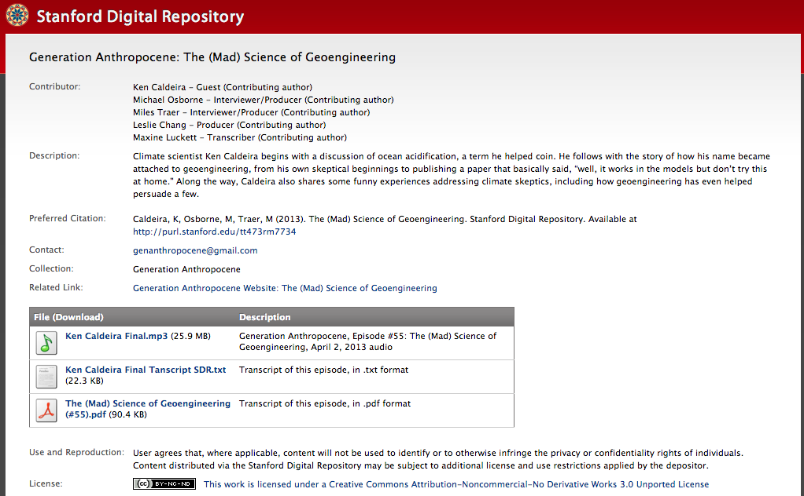
PURL for Student Science

Slide 22
Focus of Activities in US
Faculty interviews and surveys
Development of data services web sites
Data management plan training and consultation, creation of data management planning tools
Development of repositories or identification of outside repositories to employ or recommend
General outreach regarding service offered

Slide 23
Looking Forward
Services around metadata support & training
Development of tools for data input or metadata capture that will integrate easily into existing researcher workflows and make preservation and sharing easier
Larger scale data preservation projects, e.g. “data rescue” projects, which may involve extended metadata assistance and/or custom discovery interfaces – similar to some of our other digital library projects, but focused on data
Better integration with other campus services, like IT

Slide 24
SDR Project 1: Chris Gerdes, Mechanical Engineering
Development of driver assistance systems: instrumenting car and driver simultaneously
Where the car is > GPS
What the car is doing: engine, suspension, etc.
What the driver is doing: brake, throttle, clutch, steering
Driver physiology: heart rate, respiratory rate, brain wave data
Cameras recording the event > VIDEO
Driver post-race interviews

Slide 25
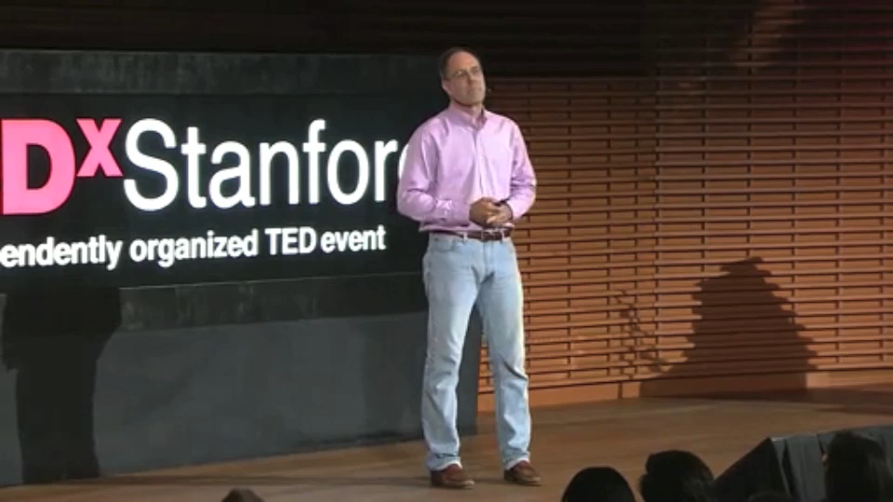
Chris Gerdes TED^{x}Stanford Talk
Notes:
May 2012

Slide 26
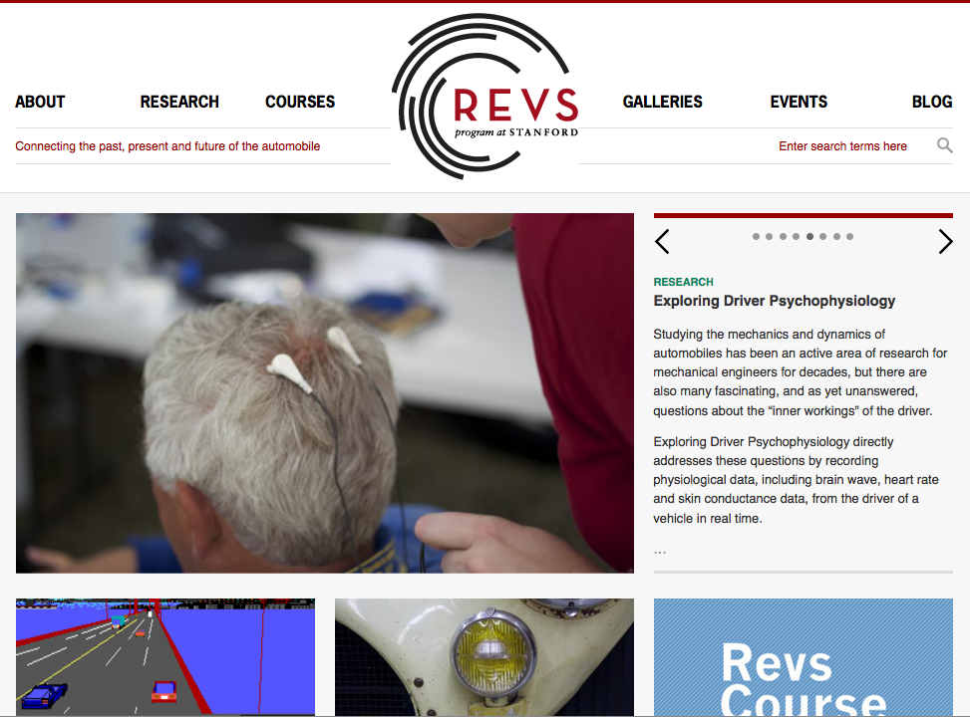
Stanford REVS

